Slide 1
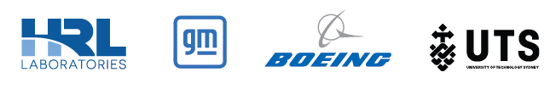
Quantum Benchmarking in Aerospace, Automotive, and Biotechnology Fullerene-encapsulated Cyclic Ozone for the Next Generation of Nano-sized Propellants via Quantum Computation
Speaker: Thomas Watts, HRL Laboratories, LLC
PI: Adam Holmes, HRL Laboratories, LLC
Team Leads: Michael (Mick) Bremner, UTS; Marna Kagele, The Boeing Company
DARPA/DSO
Quantum Benchmarking
June 11 – 13, 2024
Program Review

Slide 2
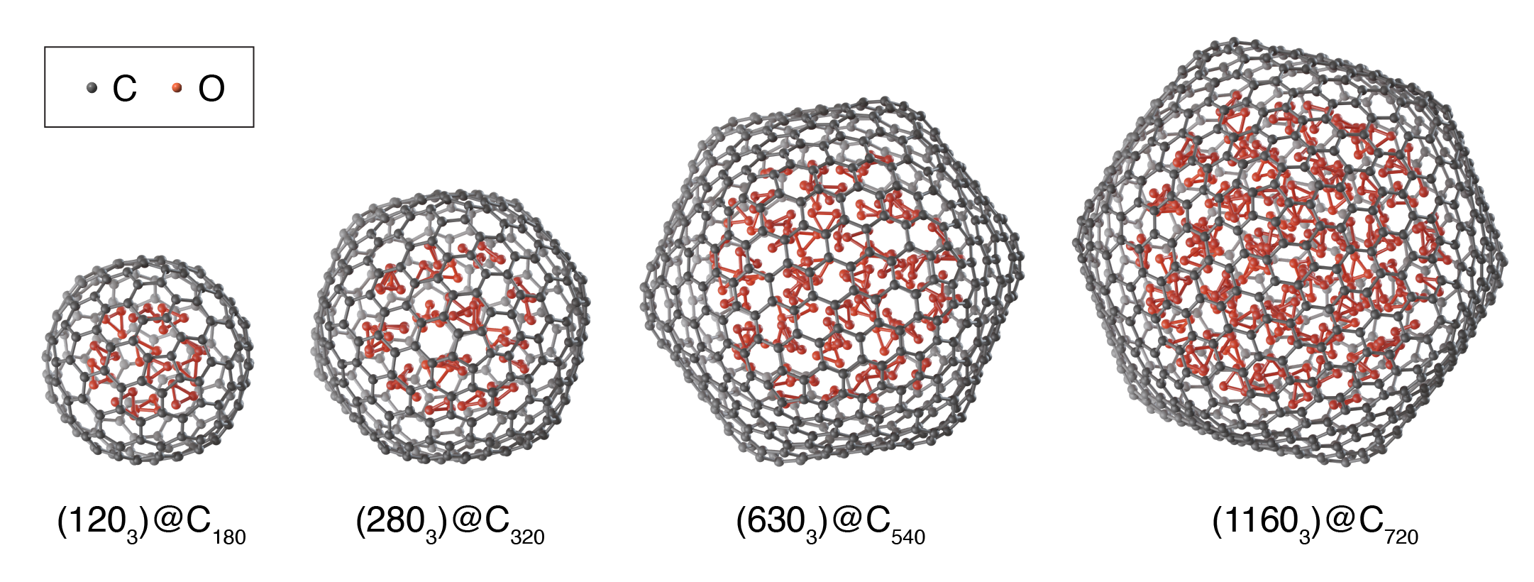
Quantum Benchmarking in
Aerospace, Automotive, and Biotechnology
Executive Summary

Slide 3
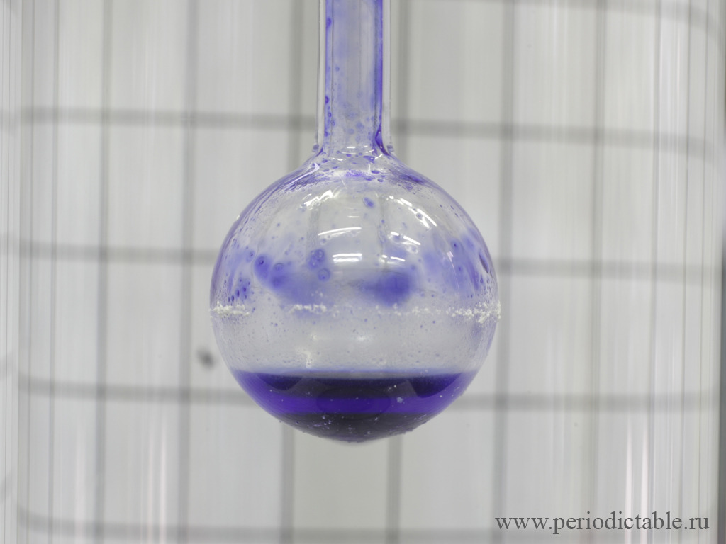
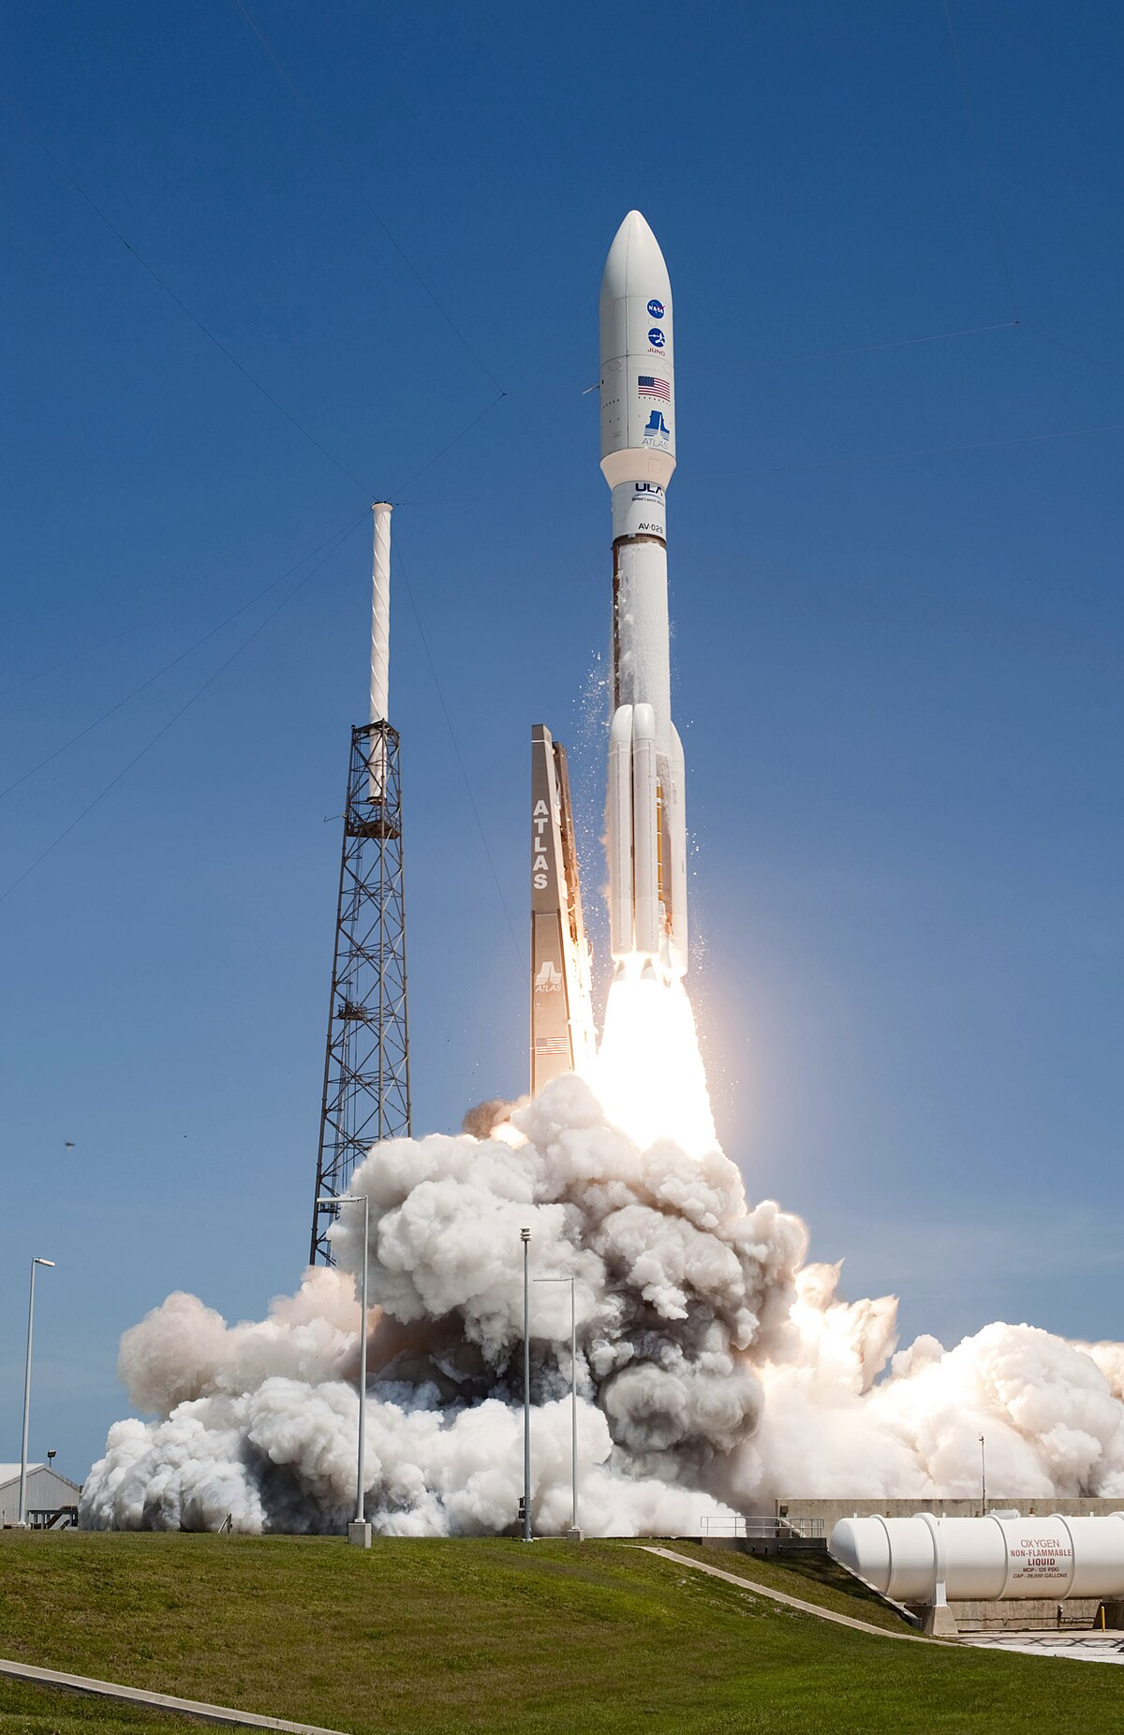
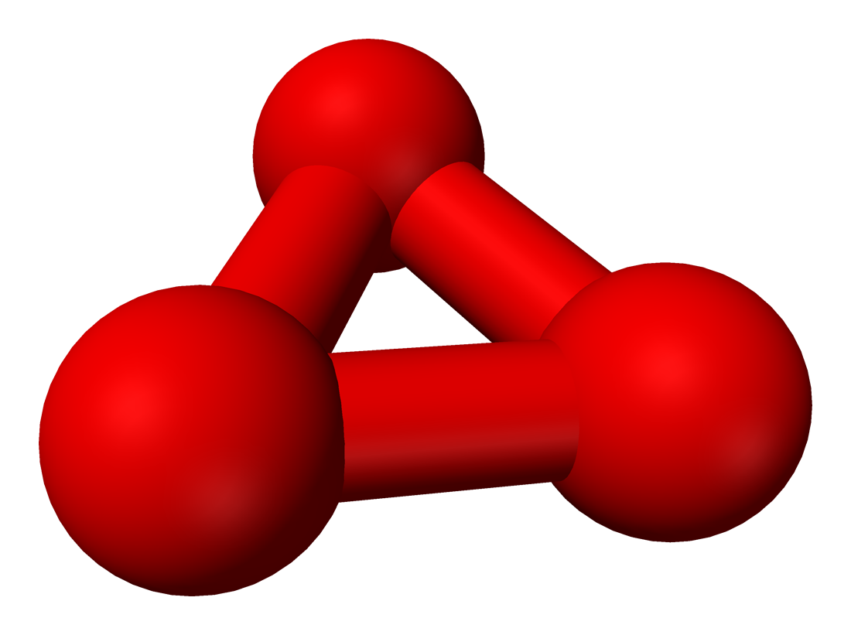
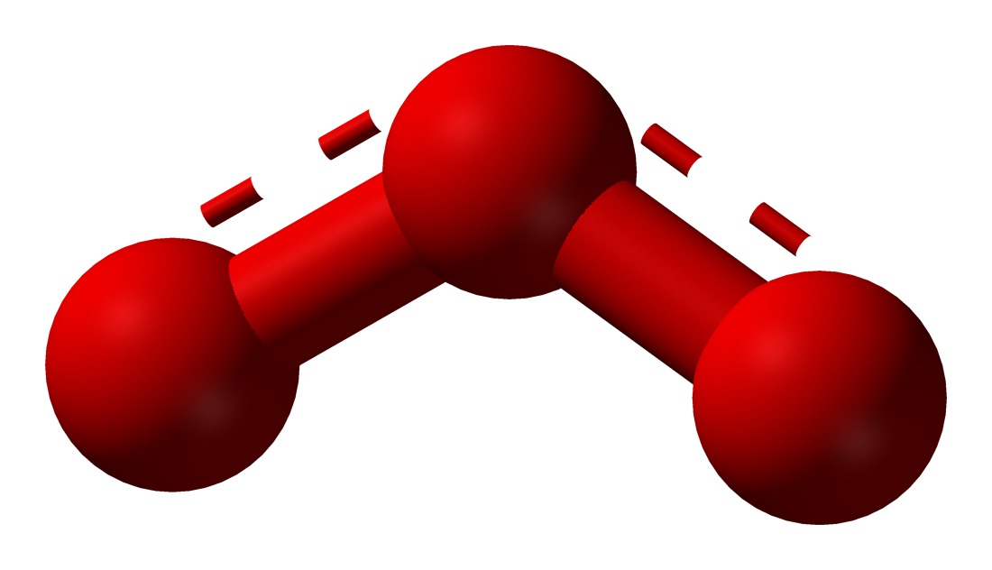
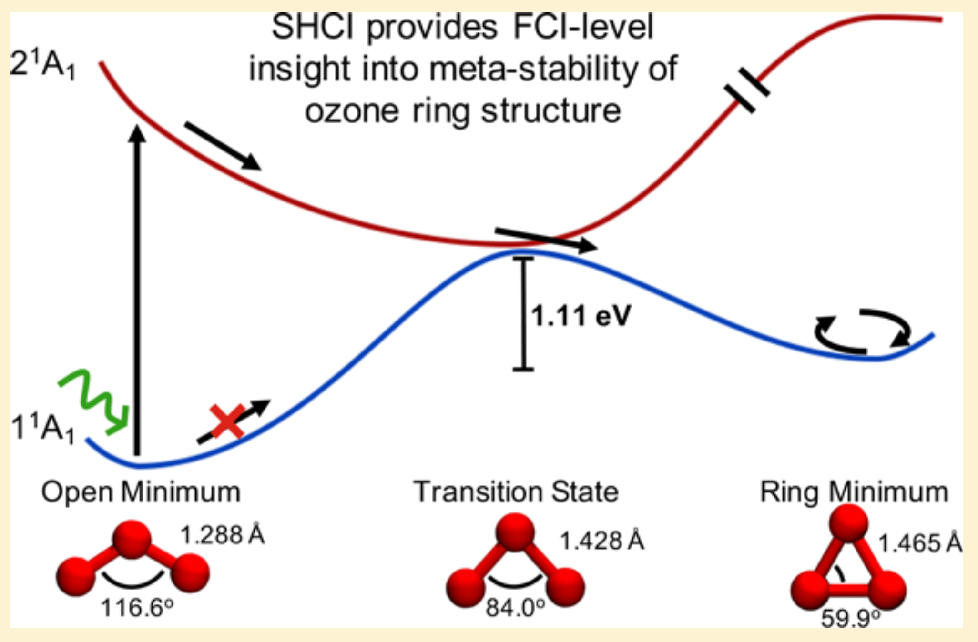
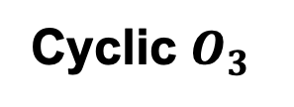
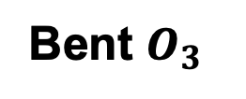
The Elusive Cyclic Form of Ozone
Cyclic $O_{3}$
Bent $O_{3}$
Temple University's Center for Advanced Photonics Research was awarded a one-year, $1.25 million grant to develop cyclic ozone by the Defense Advanced Research Projects Administration (DARPA, 2005)
Cyclic ozone offers the potential for up to an extra 1/3 more payload (kg) per rocket when burned with liquid hydrogen

Slide 4
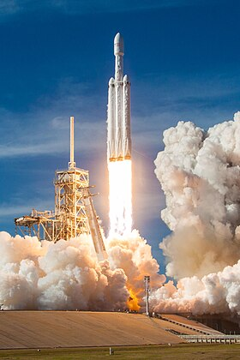
Derived Utility
With a reusable rocket, the Falcon heavy can carry 63,800 kg to LEO and 26,700 kg to GTO at a launch cost of $ 97 million. This equates to $ 1520 per kg to LEO and $ 3633 per kg to GTO.
If cyclic ozone was capable of allowing these rockets to carry one third more payload, this would equate roughly to a value of $ 32 million per rocket
SpaceX aims for 148 launches in 2024, at this rate of launches, if constant, would save 47.36 billion dollars over 10 years

Slide 5
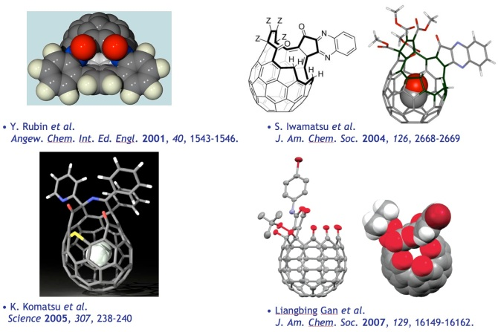
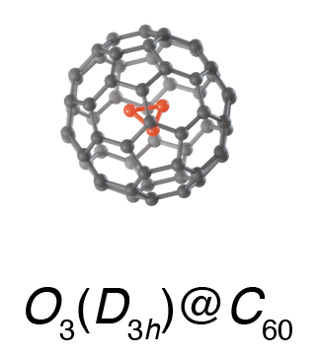
Fullerene Surgery
Encapsulating small molecules within fullerene cages shows promise for a novel method of chemical synthesis

Slide 6
The Hierarchy of Endofullerenes
Density Functional Theory (DFT) captures the geometry of these systems but fails to produce FCI-quality GSEs
Notes:
Relaxed Geometries classically with DFT, PBE Functional, cc-pVTZ basis, & D3 Dispersion

Slide 7
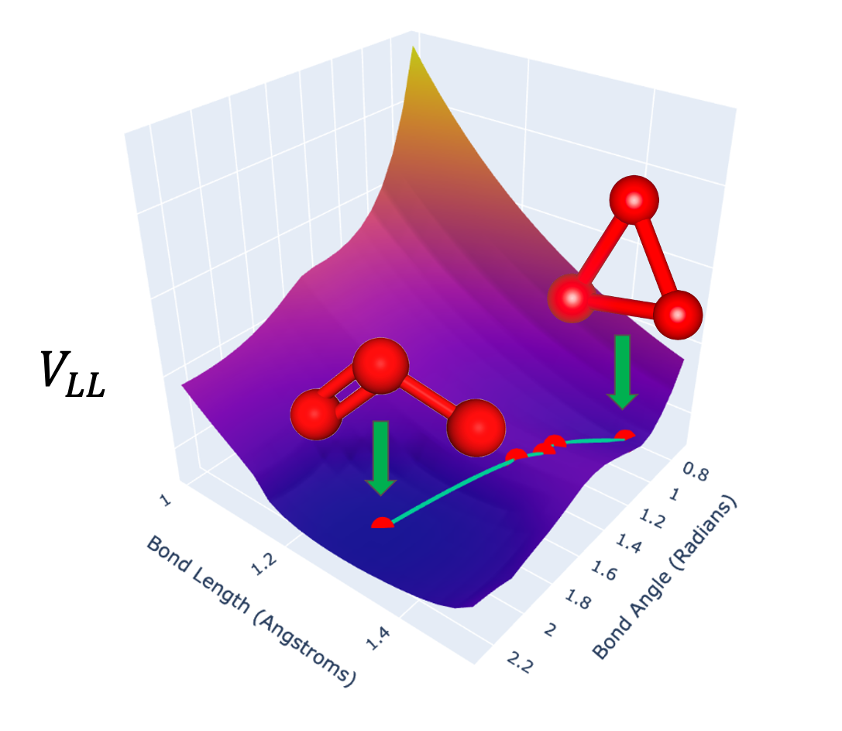
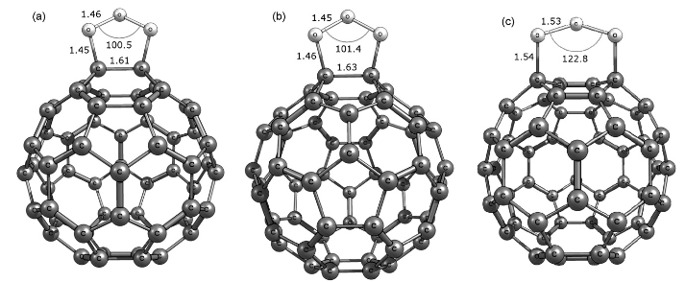
Quantum Benchmarking in
Aerospace, Automotive, and Biotechnology
Quantum Computational Formulation

Slide 8
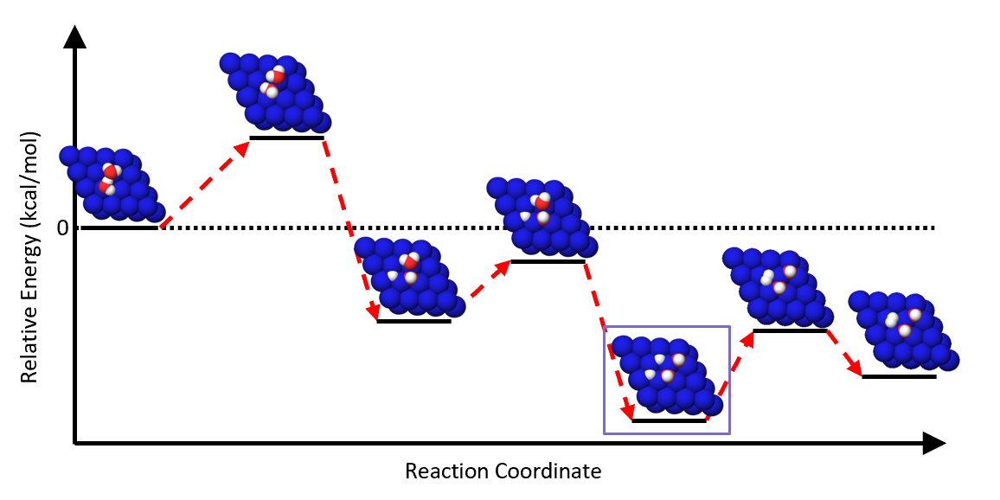
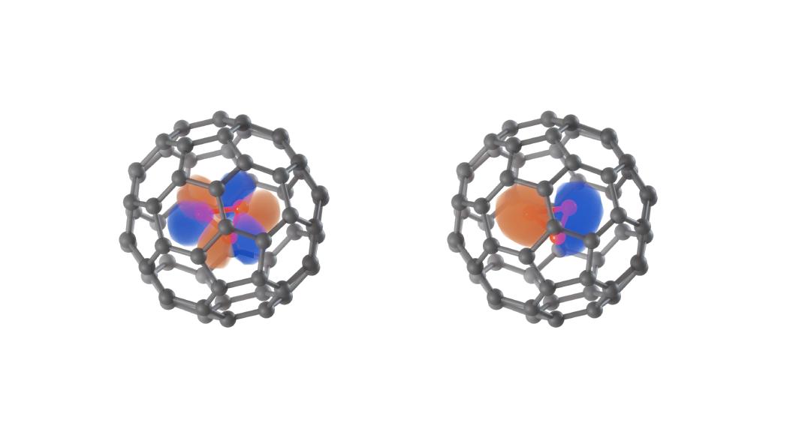
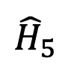
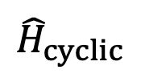
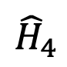
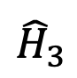
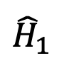
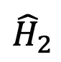
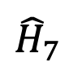
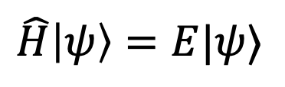
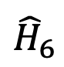
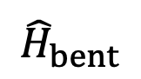
Electronic Structure and Ground State Energy Estimation (GSEE)
$$\hat{H}\left|ψ\right\rangle =E|ψ⟩$$
$${\hat{H}}_{2}$$
$${\hat{H}}_{cyclic}$$
$${\hat{H}}_{1}$$
$${\hat{H}}_{4}$$
$${\hat{H}}_{6}$$
$${\hat{H}}_{5}$$
$${\hat{H}}_{bent}$$
$${\hat{H}}_{7}$$
$${\hat{H}}_{3}$$
Quantum computers offer an avenue for computing the thermodynamics of larger, more complex chemical reactions

Slide 9
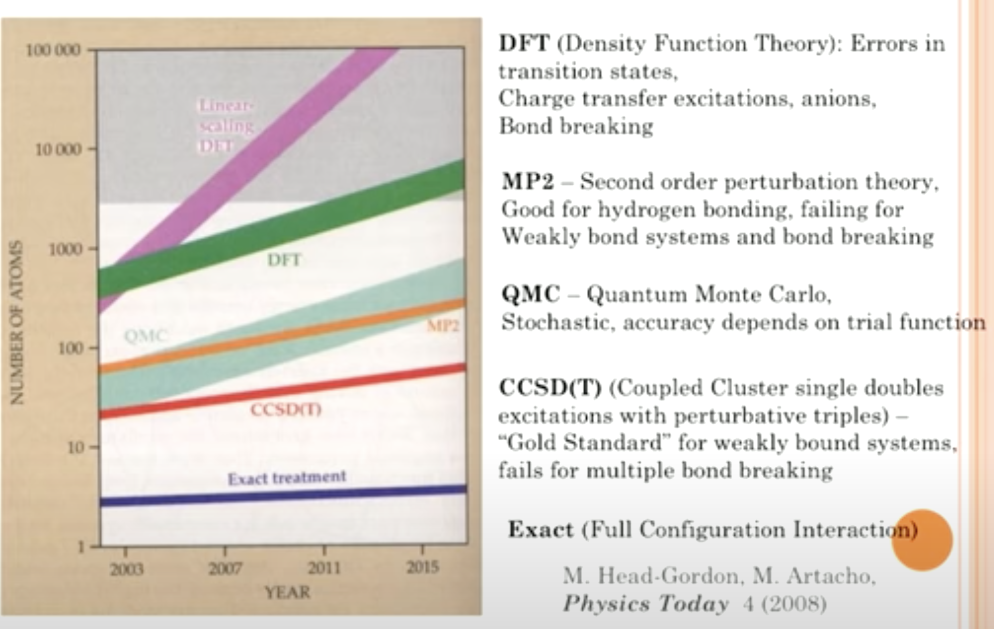
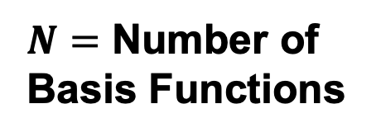
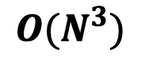
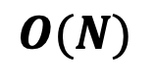
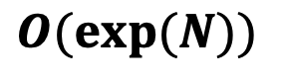
FCI-level Ground State Energies
Linear DFT
DFT
$$O(N)$$
$$O(N^{3})$$
$N=$ Number of Basis Functions
$$O(\exp{(N))}$$
FCI

Slide 10
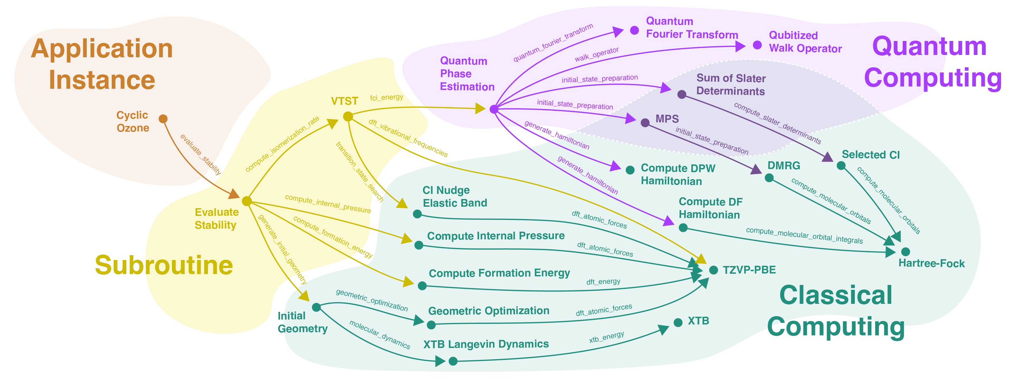
Quantum Benchmarking Graph for Cyclic Ozone
A computational schema for utilizing quantum FCI-quality energies in a larger classical workflow

Slide 11
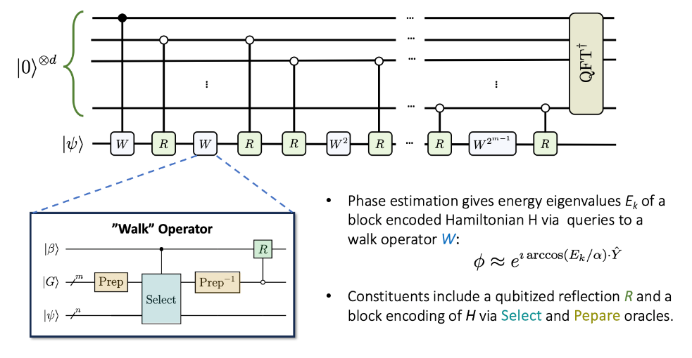
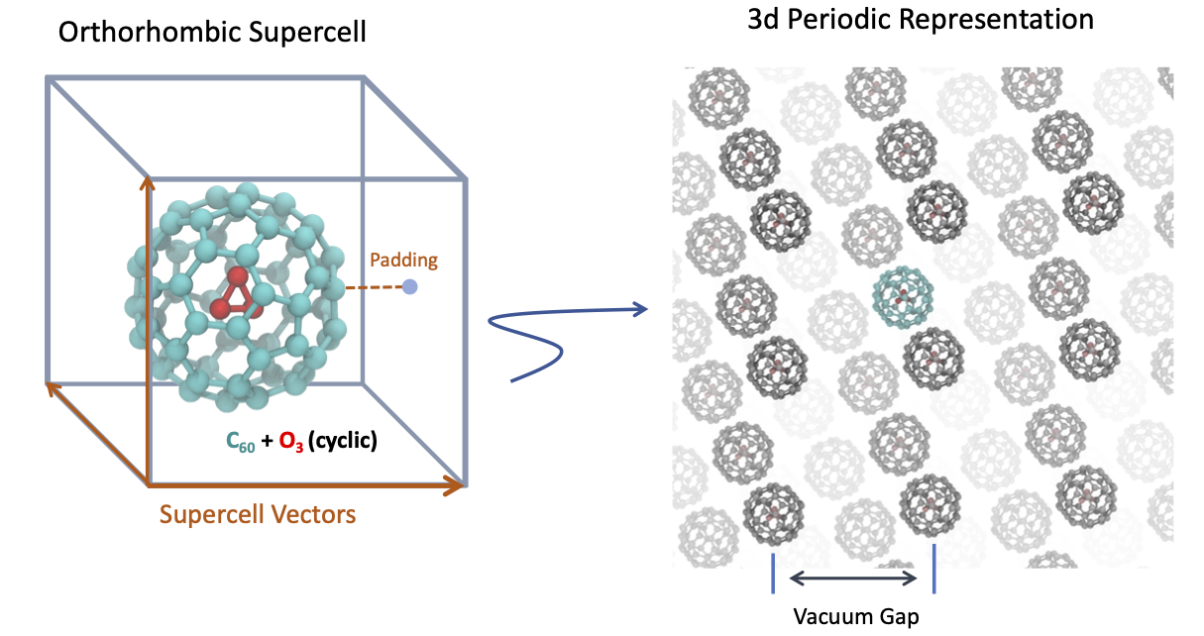
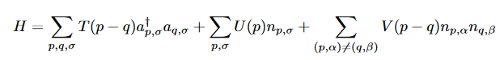
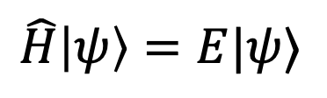

Quantum Phase Estimation with Qubitization Framework using Linear T Complexity Block-Encoding
$$\hat{H}\left|ψ\right\rangle =E|ψ⟩$$
$$\hat{H}$$

Slide 12
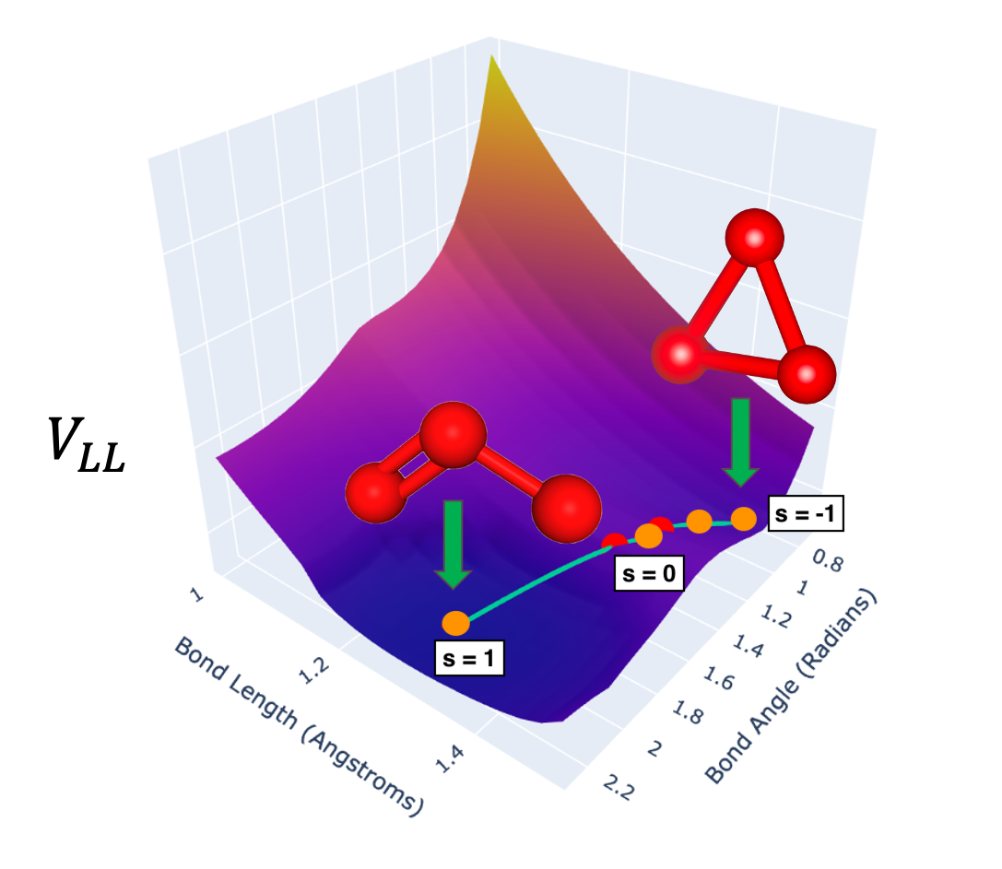

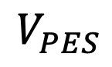
Quantum Variational Transition State Theory (VTST) for Complex Isomerization Reactions
Use FCI-quality ground state energies (GSEs) to fit a correction function (Eckart potential) that corrects energy estimates from a low-level of theory calculation
e.g., DFT
$$V_{PES}$$
For this VTST interpolation scheme, we only need 4 GSEs $V_{PES}\left( s= \right)$from quantum computations
Density Functional Theory (DFT) captures the geometry of these systems but fails to produce FCI-quality GSEs

Slide 13
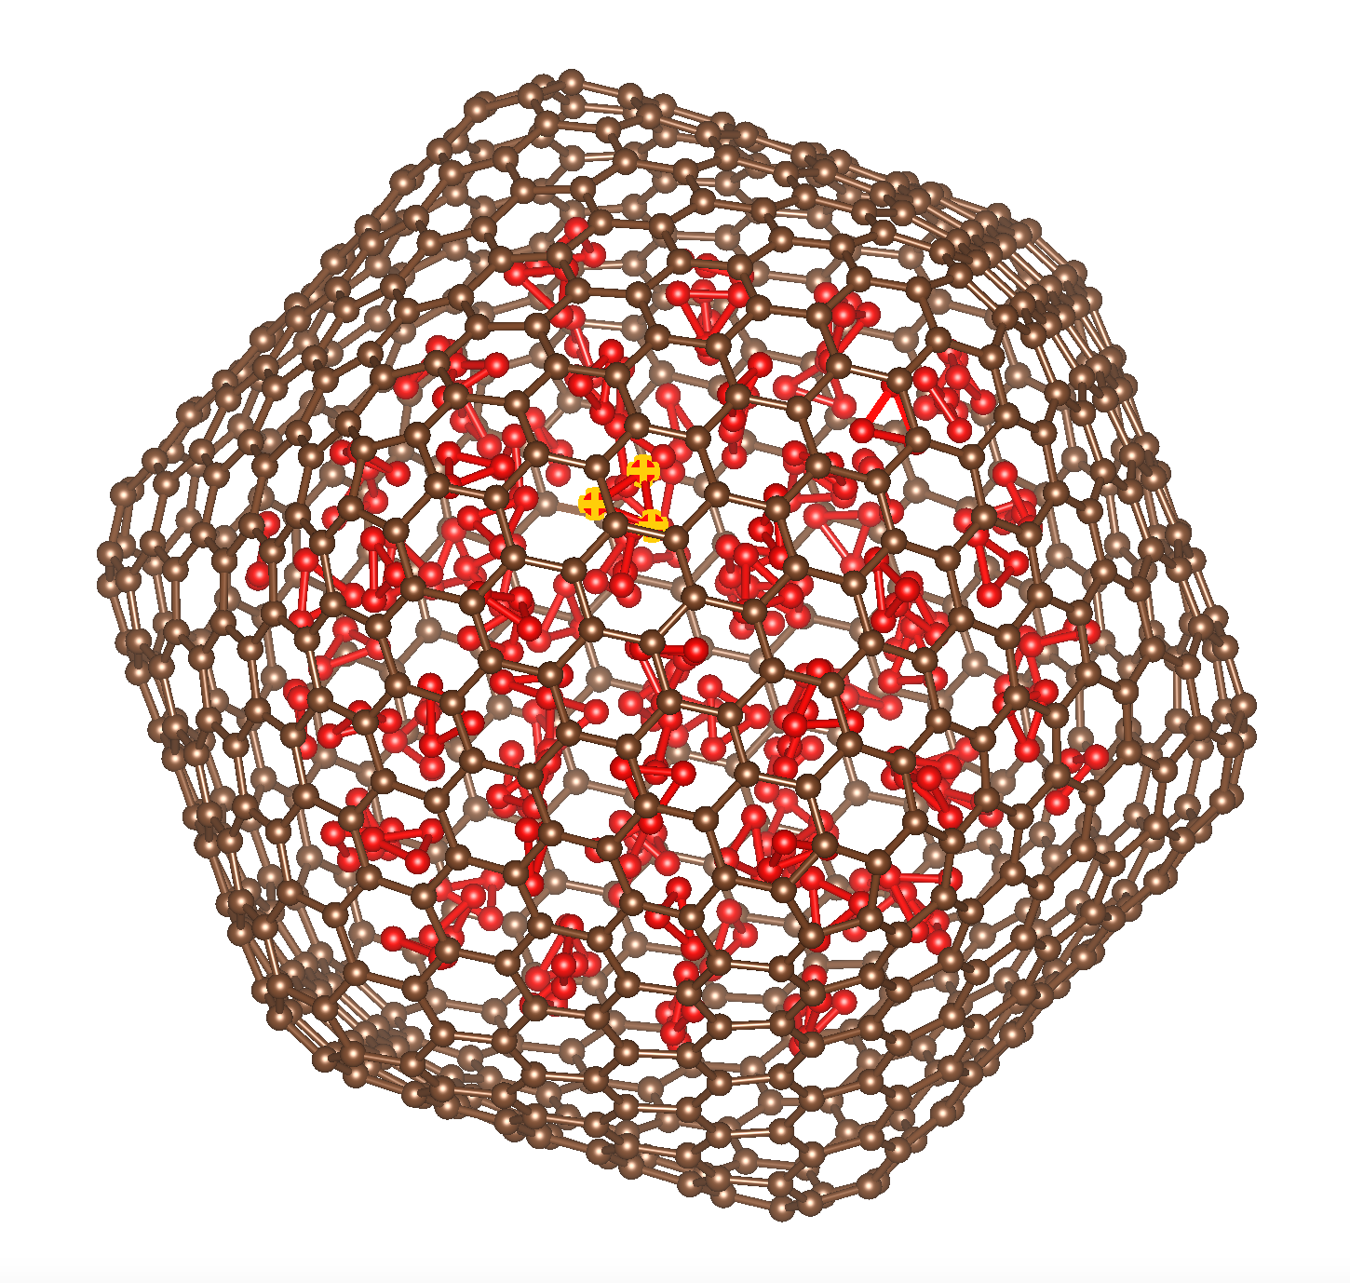
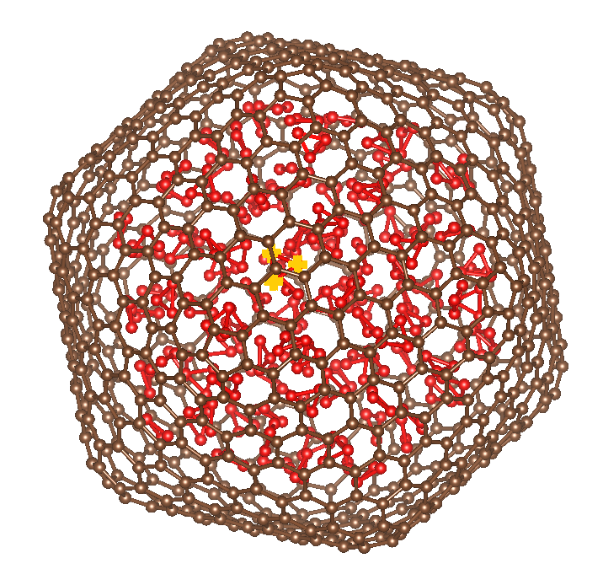
Larger Fullerenes $\left(116O_{3}\right)@C_{720}$

Slide 14
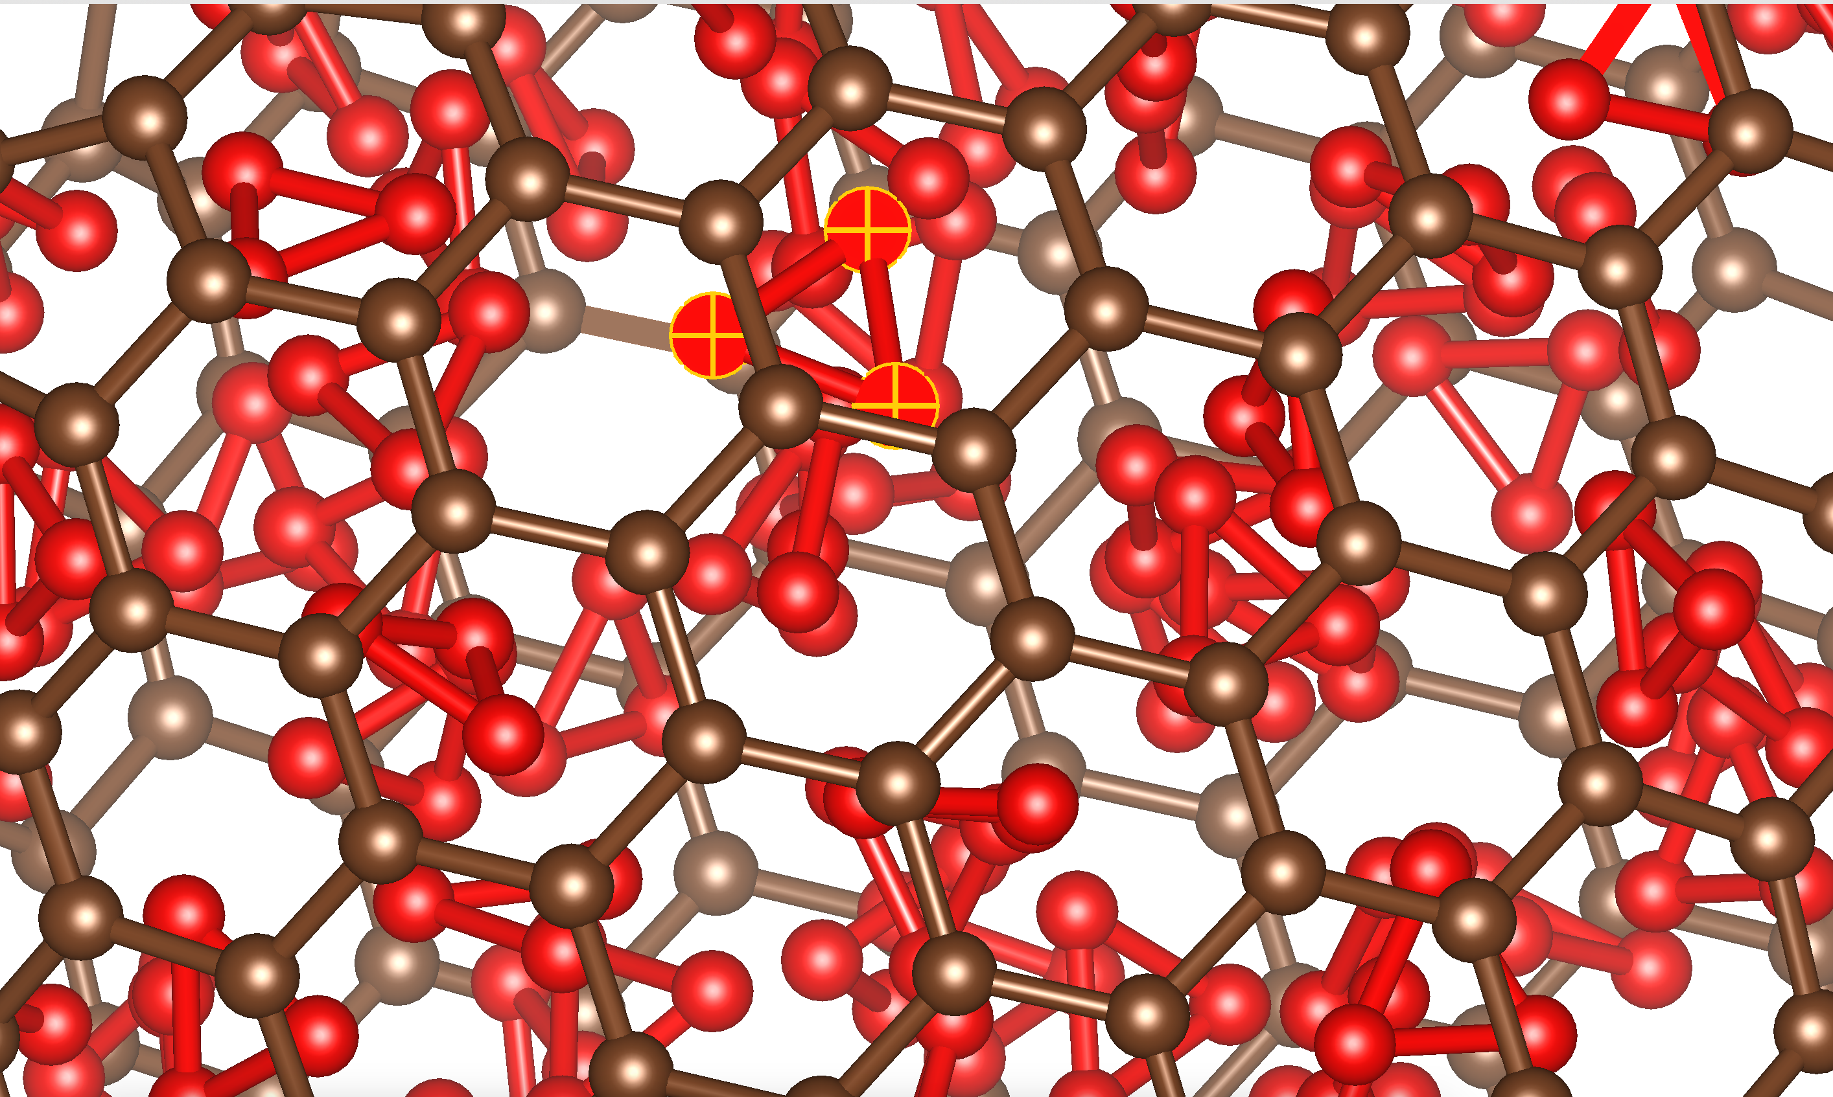
$$\left(116O_{3}\right)@C_{720}$$
464 GSEs to evaluate the stability of all 116 ozone molecules

Slide 15
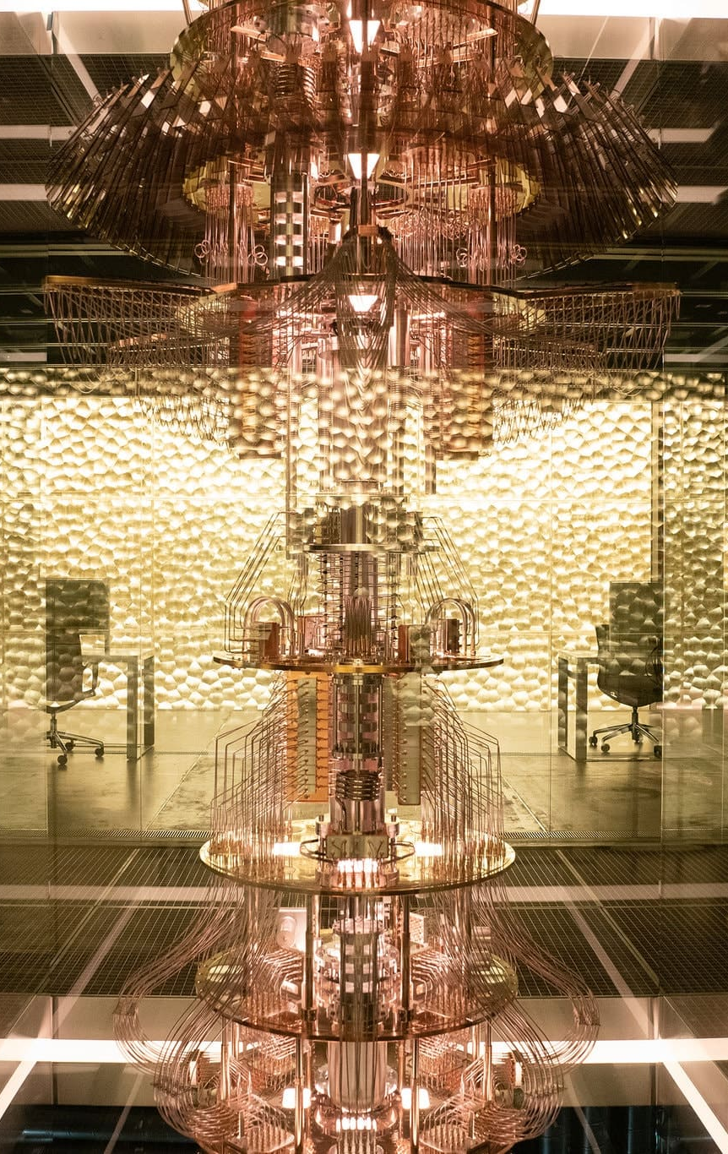
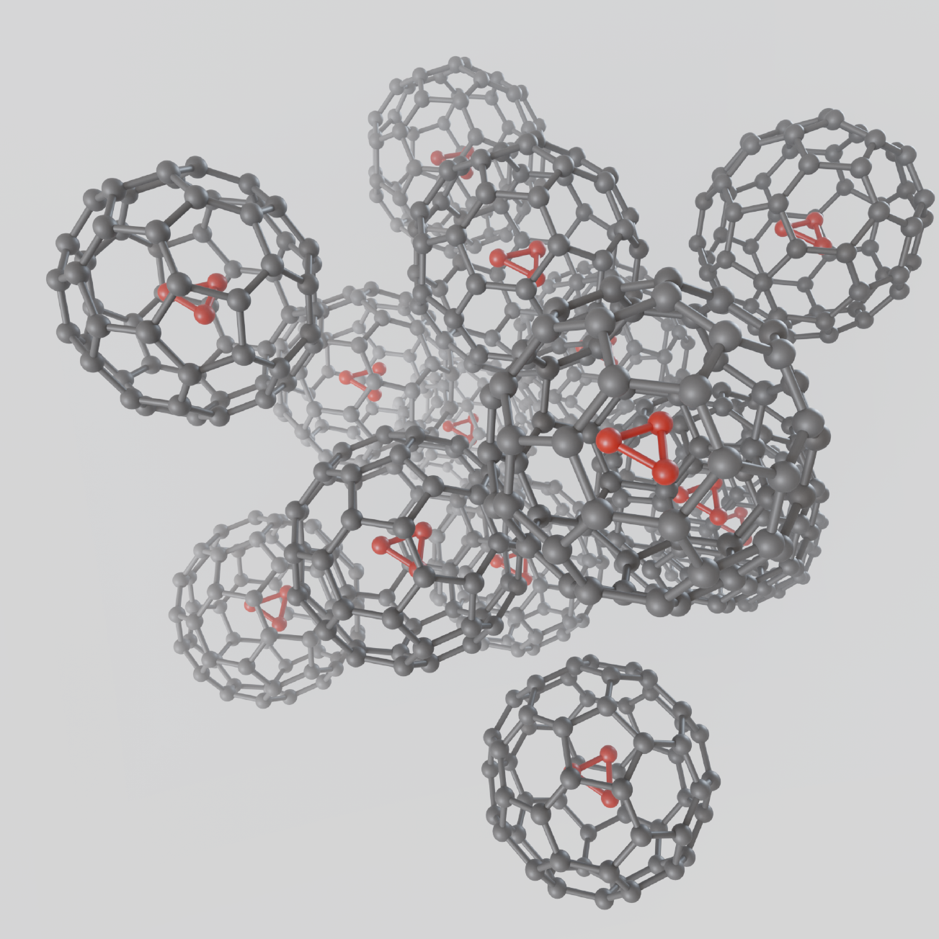
Quantum Benchmarking in
Aerospace, Automotive, and Biotechnology
Resource Estimates
for
Quantum Phase Estimation

Slide 16
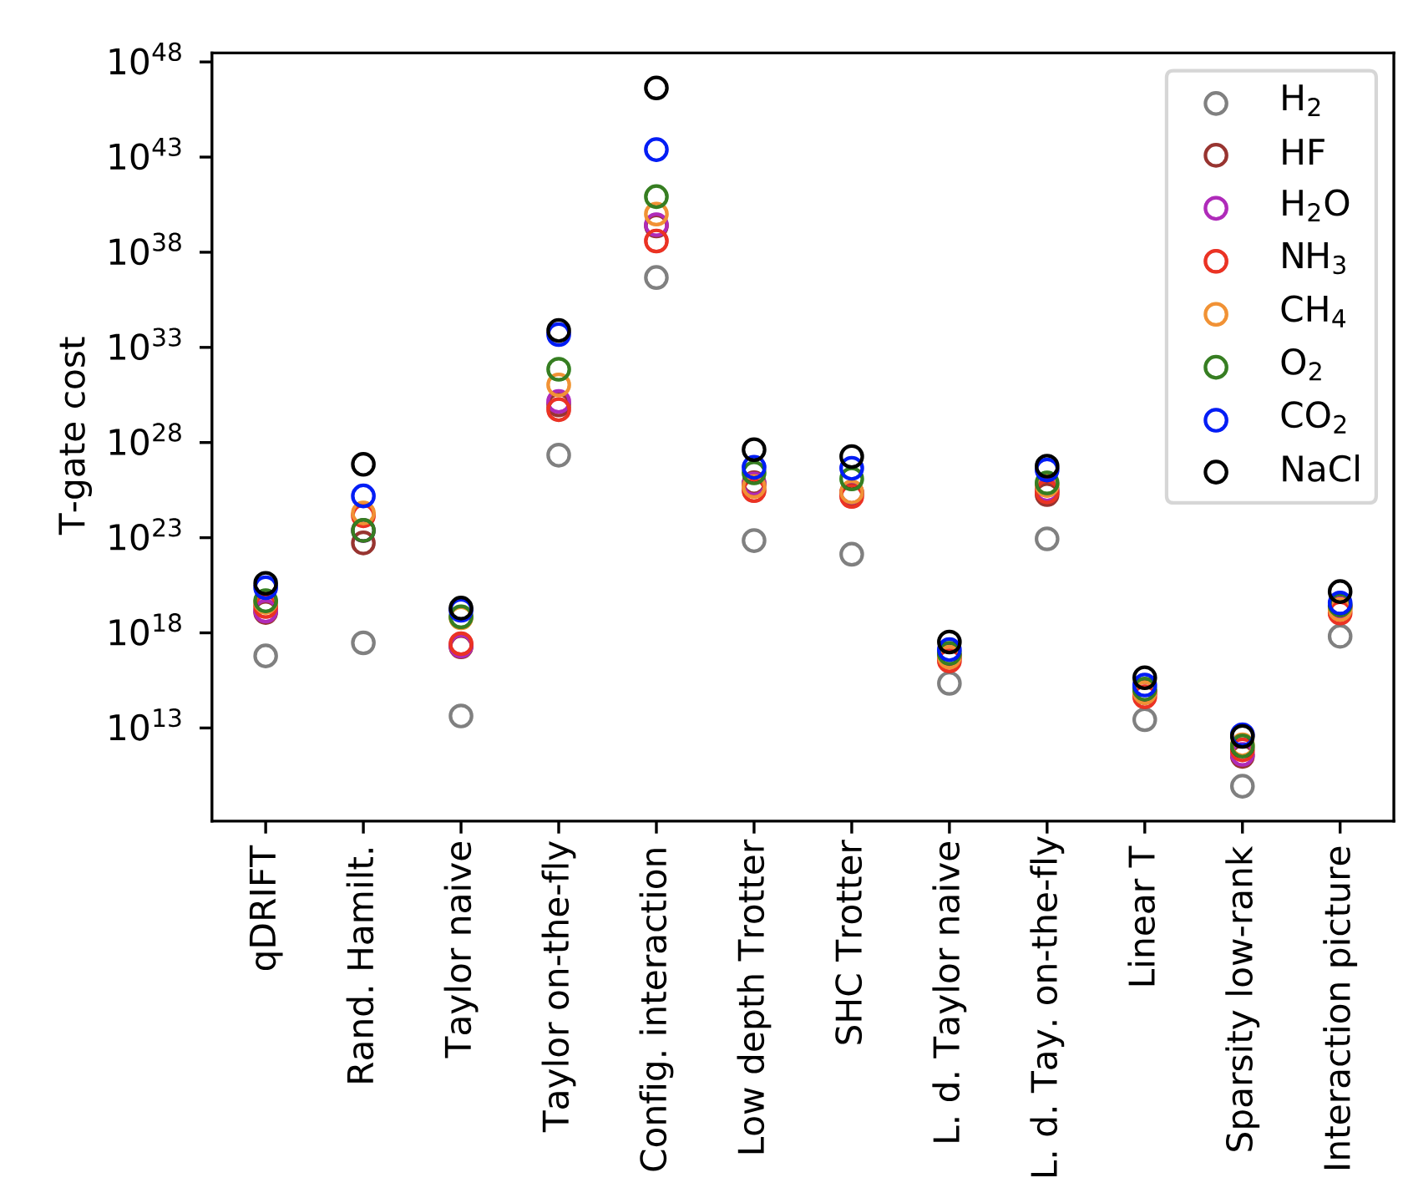

T-Fermion: T Gate Counts from Analytic Estimates arXiv:2110.05899
T Gate Cost of Quantum Phase Estimation
${10}^{48}$ T gates!!!
Classical quantum chemistry made previously exponentially difficult problems soluble by using clever techniques to bring FLOPs down orders of magnitude
The same will be true of T gate cost for implementing quantum phase estimation (QPE)
Estimating Cost of Quantum Chemistry Algorithms from Analytic Formulas results in absurd quantum resource estimates

Slide 17
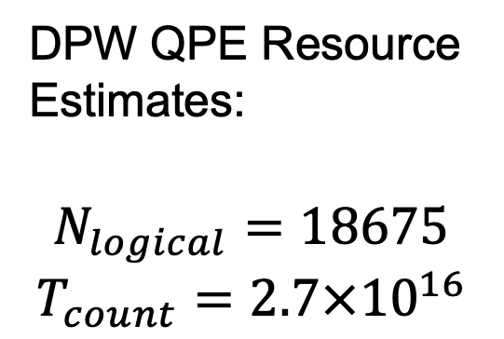

Dual Plane Wave (DPW) Representation and QPE Resource Estimation
DPW QPE Resource Estimates:
$$N_{logical}=18675$$
$$T_{count}=2.7×{10}^{16}$$
Simulation accuracy: $E_{cutoff}=40 Ry$
Density Functional Theory (DFT) captures the geometry of these systems but fails to produce FCI-quality GSEs

Slide 18
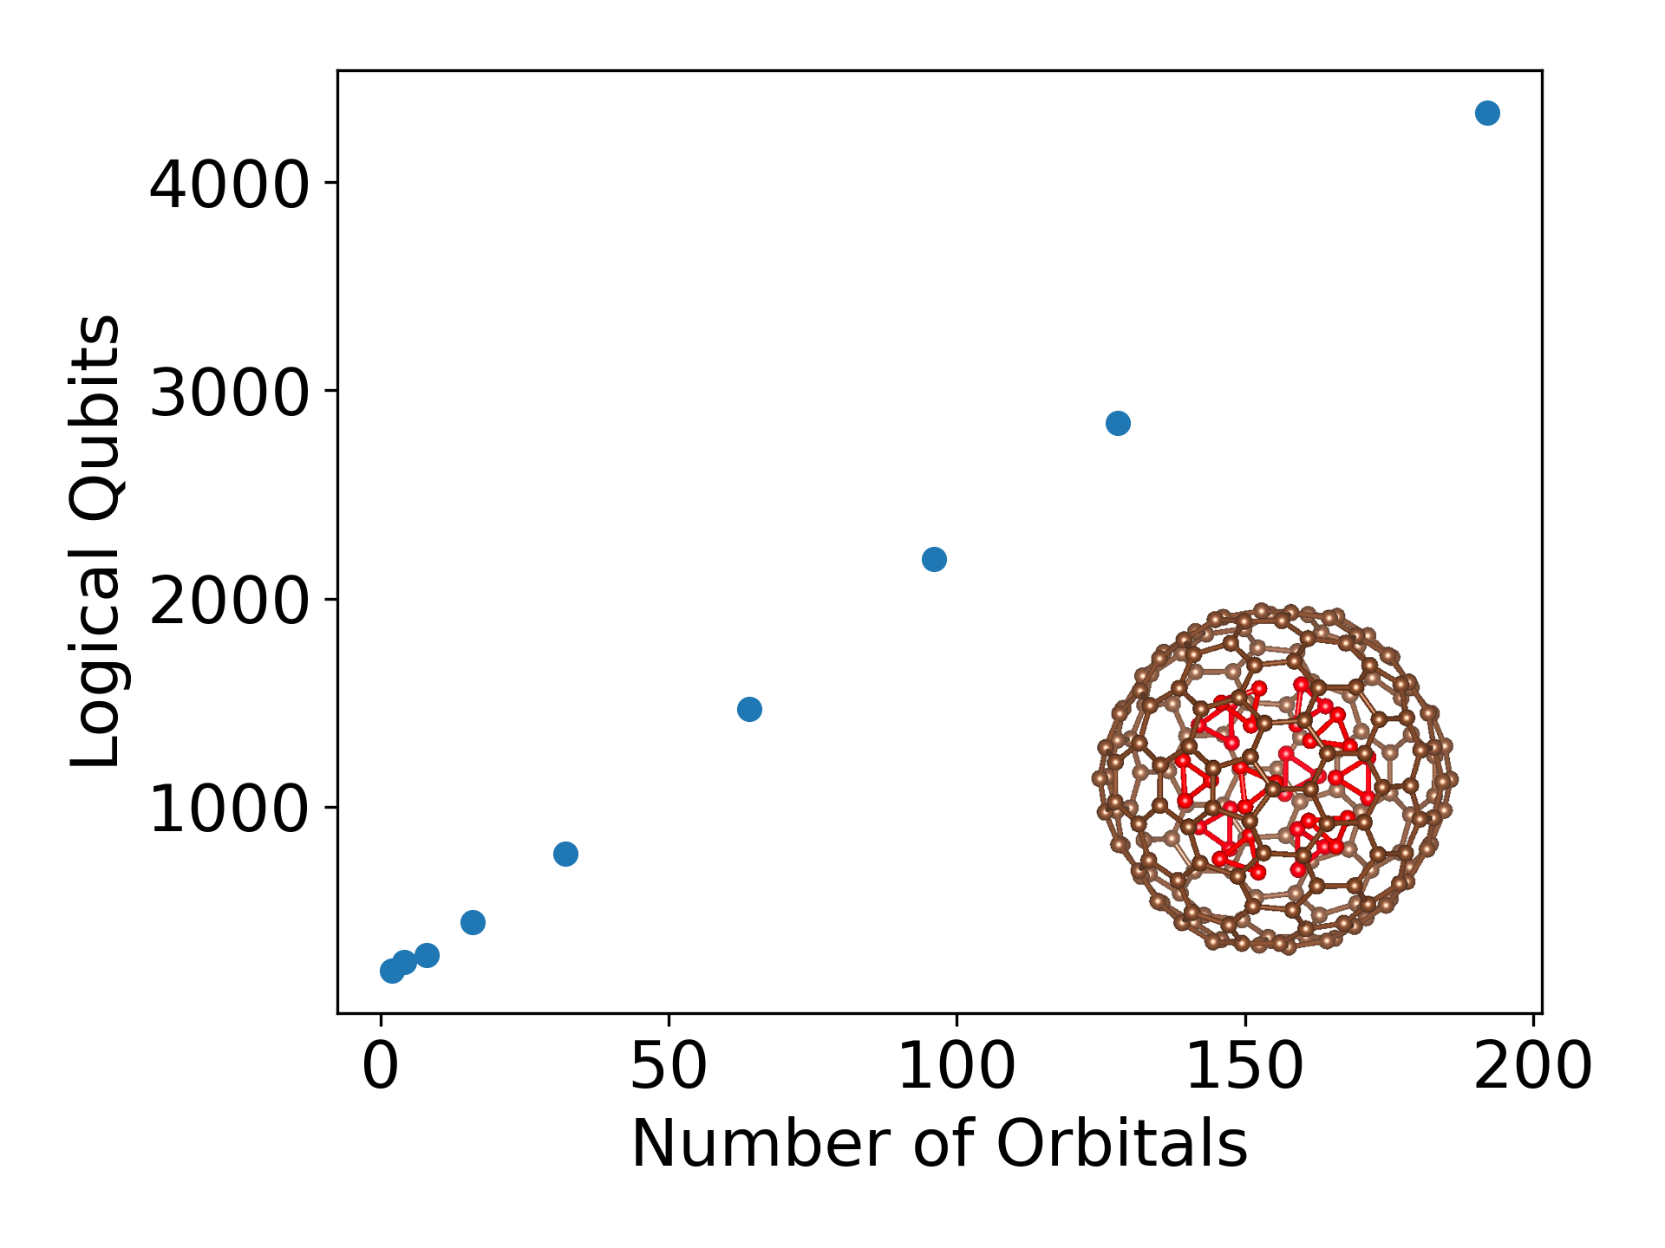
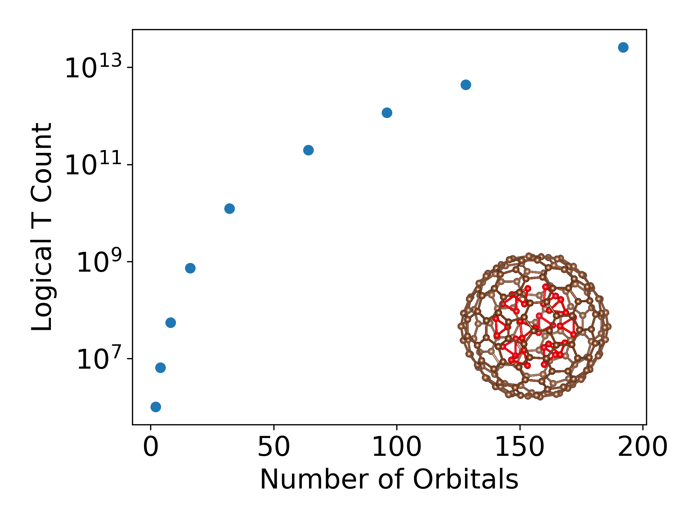
Microsoft Azure Resource Estimates: Logical Resources
$$\left(12O_{3}\right)@C_{180}$$

Slide 19
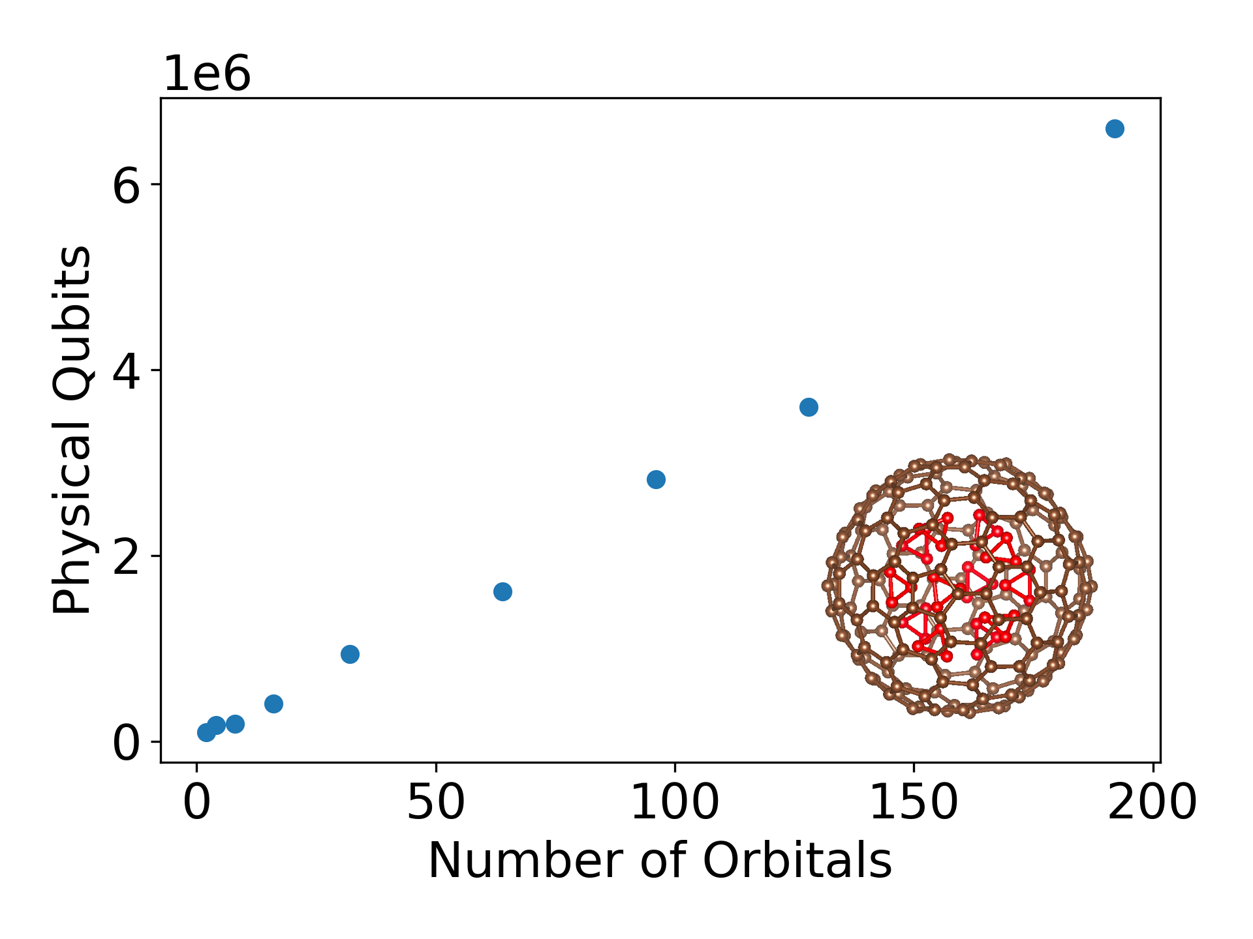
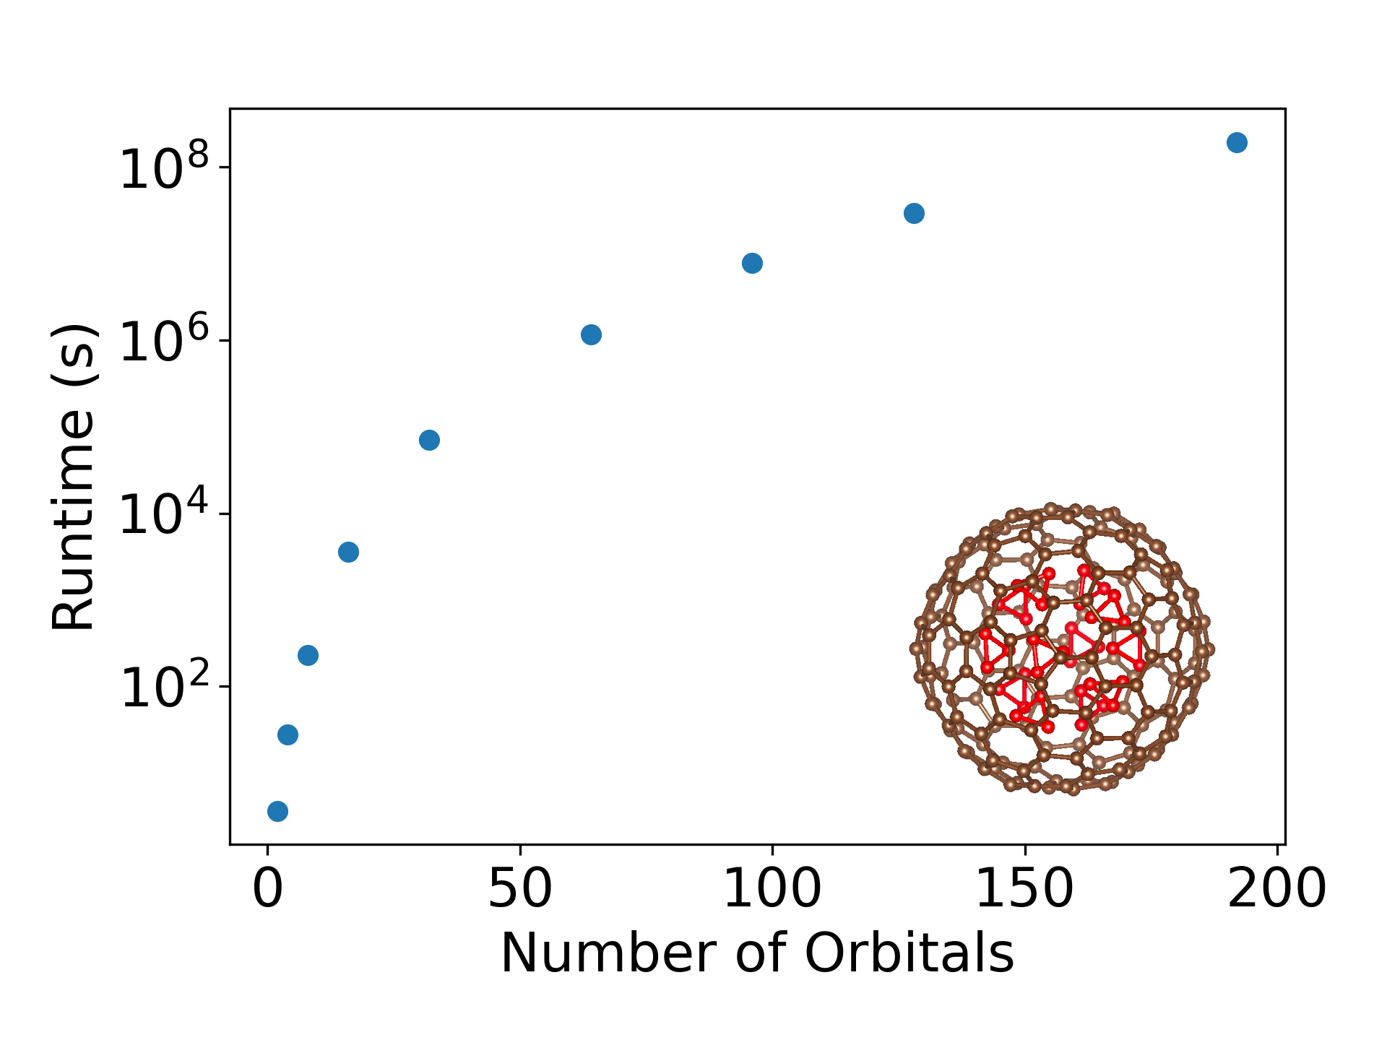
Microsoft Azure Resource Estimates: Physical Resources
$$\left(12O_{3}\right)@C_{180}$$

Slide 20
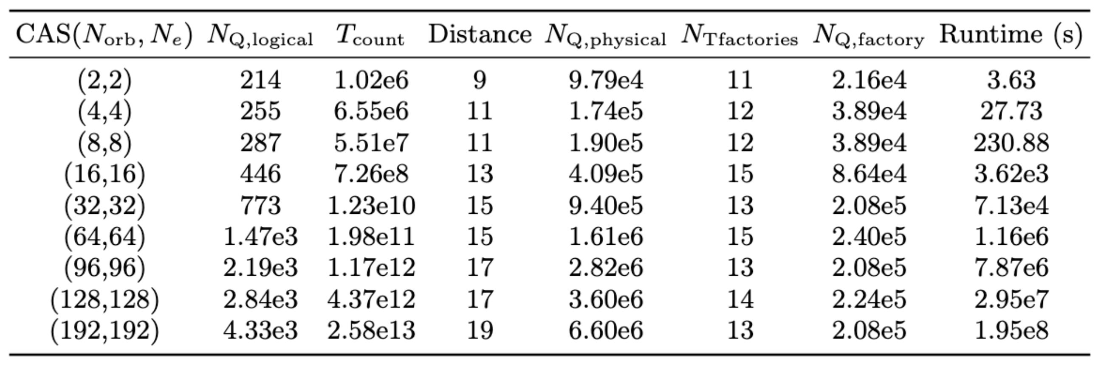
Microsoft Azure Resource Estimates: Logical and Physical Resources

Slide 21



Quantum Embedding Techniques with Unbounded Approximations
Localized Gaussian Basis, ”triple zeta”: cc-pVTZ
Double Factorized QPE Resource Estimates:
$$N_{logical}=515$$
$$T_{count}=3.5×{10}^{8}$$
$$O_{3}@C_{60}$$
$$N_{e}=22, { N}_{so}=28$$
$$t_{ij}^{AS}=ε_{ij}^{HF}δ_{ij}−\sum_{k∈AS occ.}{V_{ikjk}−V_{ikkj}δ_{σ_{i}, σ_{k}}}$$

Slide 22


Quantum Benchmarking in
Aerospace, Automotive, and Biotechnology
Conclusion
$$t_{ij}^{AS}=ε_{ij}^{HF}δ_{ij}−\sum_{k∈AS occ.}{V_{ikjk}−V_{ikkj}δ_{σ_{i}, σ_{k}}}$$
Quantum Embedding
$$V≈\frac{1}{2}\sum_{μ,ν=1}^{M}{\sum_{α,β∈\{↓,↑\}}{ζ_{μ,ν}n_{μ,α}n_{ν,β}}}$$
Tensor Hypercontraction

Slide 23
Future Directions
Ways to improve costs
Better model selection
Ozone Downfolding / Quantum Embedding
Better encoding selection (Hamiltonian)
Nb-rich -> 1st Quantized
Ozone -> Tensor hypercontraction
Compilation of quantum circuits
pyLIQTR, Qualtran, etc…
Better algorithms and workflows
Initial state preparation and number of shots (QPE)

Slide 24





Even more Efficient Chemistry with Tensor Hypercontraction (arXiv: 2011.03494)
$$V≈G=\frac{1}{2}\sum_{μ,ν=1}^{M}{\sum_{α,β∈\{↓,↑\}}{ζ_{μ,ν}n_{μ,α}n_{ν,β}}}$$
Double Factorization
Tensor Hypercontraction
$$\tilde{O}(Nλ_{DF}\sqrt{L}/ε)$$
vs.
$$\tilde{O}(Nλ_{TH}/ε)$$

Slide 25
Quantum Benchmarking in
Aerospace, Automotive, and Biotechnology
Extra Slides

Slide 26




”The future is 1st quantized”
arXiv: 2105.12767, Su, et al.
DPW Space Complexity $O\left(N_{so}\right)$
Plane Wave Space Complexity $O(N_{e}\log{N_{so})}$
T-Fermion Estimates for Li-ion Cathode
arXiv:2204.11890
Notes:
T fermion was used!

Slide 27

Dual Plane Wave Resource Estimates with pyLIQTR
The DPW encoding has high qubit cost!
Notes:
What is the size that you computed?
For target cutoff 30 Ry, this is the resources, the rest of explanation of resolutions of calculations and how we need a bigger and faster qc

Slide 28





Chemical Synthesis within Carbon Nano-cages (Endofullerenes)
S. Naseri and M. Bock, Endohedral fullerenes having enclosed therein one or more ozone molecules, and their use as a UV-absorbing agent, Google Patents, 2014.
Hydrogen-containing Cage opening after 800 fs MD simulation
$$C_{60}$$
Notes:
10^-15 seconds = 1 fs

Slide 29

Burning Oxygen-containing Endofullerenes
S. Naseri and M. Bock, Endohedral fullerenes having enclosed therein one or more ozone molecules, and their use as a UV-absorbing agent, Google Patents, 2014.
Ermakov, V., Alaferdov, A., Vaz, A. et al. Burning Graphene Layer-by-Layer. Sci Rep 5, 11546 (2015). https://doi.org/10.1038/srep11546

Slide 30


